Slide 1

INSTITUTE :UIE
DEPARTMENT: ALL ACADEMIC UNITS
Bachelor of Engineering (All Sections)
Subject Name and Code:
Engineering Physics 23SPH-141
Prepared by: Ms. Arminder
UNIT 3
Introduction to Nanotechnology & Quantum Computing
DISCOVER . LEARN . EMPOWER

Slide 2
COURSE OBJECTIVES
The course is designed to make the students industry ready to contribute in the growing demand of the industry at local, national and international level.
It will make the students competent to understand basic concepts and applications of advanced engineering physics and apply its principles in their respective fields at global platform.
It will enhance the skill level of the students and shall make them preferred choice for getting employment in industry and research labs.
It will give thorough knowledge of the discipline to enable students to disseminate knowledge in pursuing excellence in academic areas.

Slide 3

COURSE OUTCOME
CO Number | Title On completion of this course, the students are expected to learn | Level
CO1 | Quote the basic fundamental concepts of lasers, optical fibres, crystallography, ultrasonic oscillations, semiconductor physics, quantum mechanics and nanotechnology. | Remember, Understand
CO2 | Demonstrate the working of various lasers, fibre components, semiconductor devices; explain the behaviour of crystalline solids, quantum and nano-scale systems. | Understand
CO3 | Solve problems by applying principles related to lasers, fibres, semiconductors, oscillations, quantum and nanoscience. | Applying
CO4 | Compare various lasers and fibres, semiconducting devices, crystalline materials, structures at quantum and nanoscale on the basis of their properties for industrial applications. | Analyze
CO5 | Develop various systems using lasers, fibres, semiconductors and nanomaterials for futuristic applications. | Design

Slide 4
LECTURE OBJECTIVE
Students will learn about synthesis of nanomaterials
Students will understand about sol gel method.
Students will learn about nanocomputing.

Slide 5
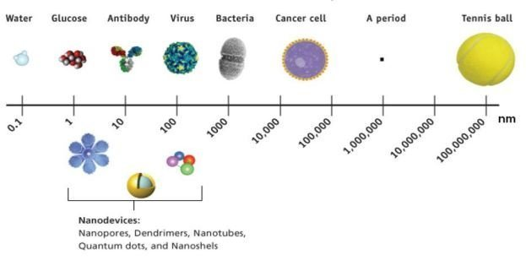
NANOMATERIALS
Nanomaterials are those materials having dimensions in the order of 1-100 nm.
1 nanometer is defined as one billionth of meter.
Figure 14.1 Nano range [1]

Slide 6
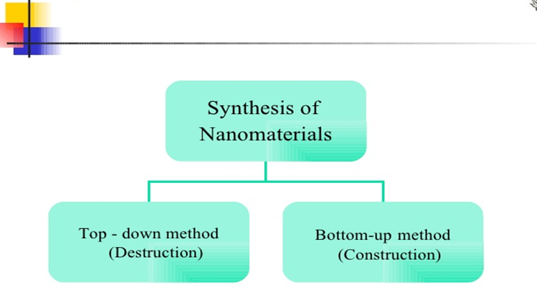
SYNTHESIS OF NANOMATERIALS
There are two approaches for synthesis of nanomaterials.
Top down approach refers to slicing or successive cutting of a bulk material to get nano sized particle and the fabrication of nano structures. It includes ball milling method.
Bottom-up refers to methods where devices 'create themselves' by self assembly. Most commonly used is sol-gel method.
Figure 14.2 Synthesis of Nanomaterials [2]

Slide 7
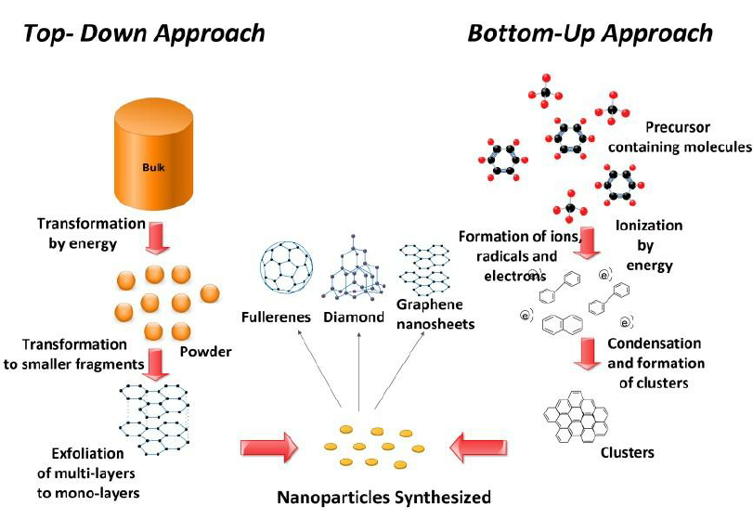
SYNTHESIS OF NANOMATERIALS
Figure 14.3 Top Down and Bottom up approach[3]

Slide 8
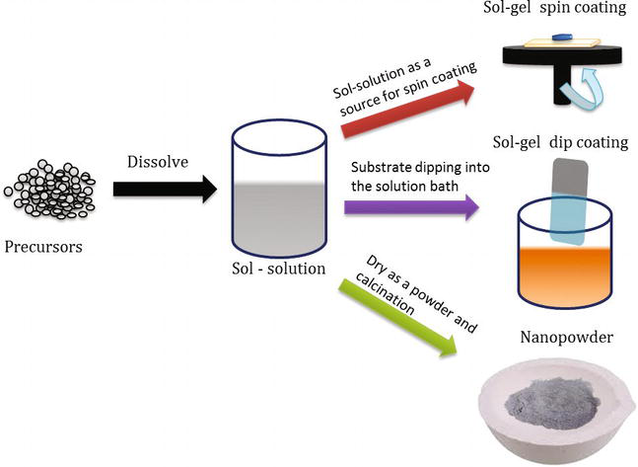
SOL-GEL METHOD
BOTTOM UP METHOD
Bottom-up refers to methods where devices 'create themselves' by self assembly. Chemical synthesis is a good example. This method is providing high yield with uniform morphology of nanoparticles.
Figure 14.4 Sol-Gel method [4]

Slide 9
SOL-GEL METHOD
The sol-gel method is a versatile process used for synthesizing various oxide materials.
This synthetic method generally allows control of the texture, the chemical, and the morphological properties of the solid. This method also has several advantages over other methods, such as allowing impregnation or coprecipitation, which can be used to introduce dopants. The major advantages of the sol-gel technique include molecular scale mixing, high purity of the precursors, and homogeneity of the sol- gel products with a high purity of physical, morphological, and chemical properties.

Slide 10
SOL-GEL METHOD
In a typical sol-gel process, a colloidal suspension, or a sol, is formed from the hydrolysis and polymerization reactions of the precursors, which are usually inorganic metal salts or metal organic compounds such as metal alkoxides.
A general flowchart for a complete sol-gel process is shown in Figure 2.
Any factor that affects either or both of these reactions is likely to impact the properties of the gel. These factors, generally referred to as sol-gel parameters, includes type of precursor, type of solvent, water content, acid or base content, precursor concentration, and temperature. These parameters affect the structure of the initial gel and, in turn, the properties of the material at all subsequent processing steps

Slide 11
SOL-GEL METHOD
After gelation, the wet gel can be optionally aged in its mother liquor, or in another solvent, and washed. The time between the formation of a gel and its drying, known as aging, is also an important parameter. A gel is not static during aging but can continue to undergo hydrolysis and condensation.

Slide 12
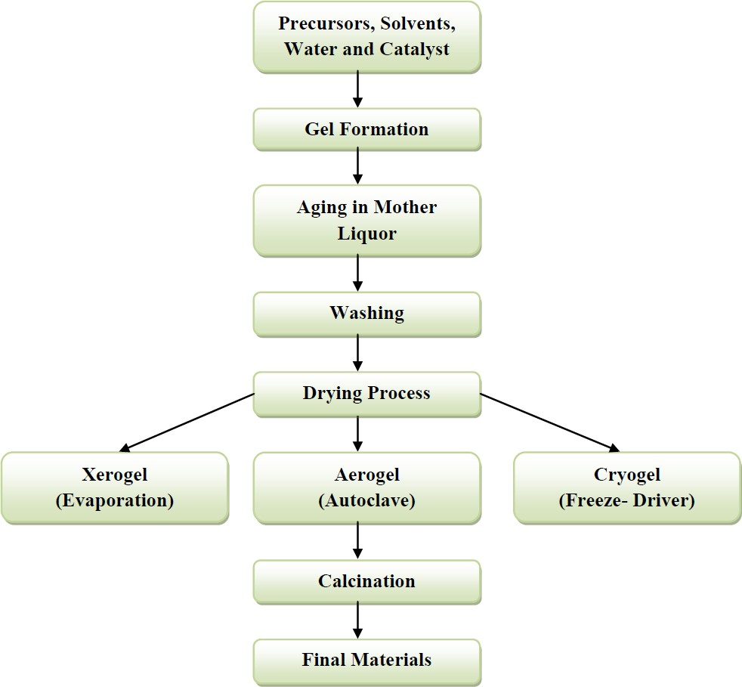
SOL-GEL METHOD
Figure 14.4: Sol-Gel and Drying Flowchart[5]

Slide 13
NANOCOMPUTING TECHNOLOGIES
Nanocomputing is a term used for the representation and manipulation of data by computers smaller than a microcomputer. Current devices are already utilizing transistors with channels below 100 nanometres in length.
The current goal is to produce computers smaller than 10 nanometers. Future developments in nanocomputing will provide resolutions to the current difficulties of forming computing technology at the nanoscale. For example, current nanosized transistors have been found to produce a quantum tunnelling effect where electrons ‘tunnel’ through barriers, making them unsuitable for use as a standard switch.
The increased computing power formed by Nano computers will allow for the solution of exponentially difficult real-world problems. Nanocomputing also has the advantage of being produced to fit into any environment, including the human body, whilst being undetectable to the naked eye. The small size of devices will allow for processing power to be shared by thousands of nanocomputers.

Slide 14
Quantum Computing
Quantum computing provides computational power at the nanoscale with abilities that reach beyond the limitations of conventional computers. This is because quantum computers store and manipulate data through the utilization of subatomic particles dynamics. Binary computers process single pieces of information as a binary state, either a 1 or a 0. Subatomic particles have two states, but can also exist in any superposition of states. This means they are governed by the laws of quantum mechanics rather than classical physics allowing them to compute solutions to problems with greater speed whilst requiring less space

Slide 15
PROSPECTS OF NANOCOMPUTING
The simulation of drug response that is more efficient than current medical trials. This will lead to the faster development of new drugs.
Greater understanding of disease development through improved computational models.
Improved transportation logistics across the world.
Improved financial modelling to avoid economic downturns.
The development of driverless cars with the ability to process real world driving problems faster than human drivers.
The rapid processing of large amounts of astronomical data for discovering new planets.
The production of quantum simulations for modeling the behaviour of subatomic particles without the need for creating the extreme conditions necessary for observing these particles.

Slide 16
CHALLENGES OF NANOCOMPUTING
Development of commercial devices for nano-computing would require solving several ‘hard’ problems. Some of these problems are discussed below.
The “interconnect problem” is one of the most challenging issues. There are two aspects of the interconnect problem. First, the minimum contact resistance to make connection between nanodevices and the external world is 6 K Ohms or more, which is very high. The second aspect concerns the large number of wires that would be needed to connect such complex devices. Adequate spacing between these wires would be needed to prevent crosstalk and capacitive coupling.

Slide 17
CHALLENGES OF NANOCOMPUTING
Current efforts are focused mostly on developing basic nano-devices that could serve as the basic building-blocks in assembling larger nano-systems. However, the nature of such integration is not yet known. Mapping of the functionality of the traditional silicon-based circuits into nano-electronics paradigm would be another challenge.
Developing circuit models for nanodevices that could be used for integration into CAD tools for design verification and simulation will require significant effort.
It would be quite a challenge to develop design and test strategies for such dense systems

Slide 18
SUMMARY
Sol Gel is chemical method.
Sol gel comes under Bottom up approach.
Quantum computing provides computational power at the nanoscale with abilities that reach beyond the limitations of conventional computers.
Quantum computing provides improved transportation logistics across the world.

Slide 19
FAQ
1.Explain Sol Gel process.
2.Define Bottom up Approach.
3.What is quantum Computing?

Slide 20
REFERENCES
[1] https://cannabisanimus.com/cbd-and-nanotechnology/
[2] https://www.slideshare.net/arunpl/nano-technology-5464209
[3]https://www.researchgate.net/profile/Khaled_Habiba/publication/270583669/figure/fig1/AS:295080373047296@1447364051162/Bottom-up-and-the-top-down-approaches-in-synthesis-of-carbon-based-nanomaterials.png
[4]https://www.intechopen.com/books/recent-applications-in-sol-gel-synthesis/facile-methodology-of-sol-gel-synthesis-for-metal-oxide-nanostructures
[5] M. Fernandez-Garcia, A. Martinez-Arias, J. C. Hanson, J. A.Rodriguez, Nanostructured Oxides in Chemistry: Characterization and Properties. Chem. Rev., 104, (9), 4063-4104, (2004).

Slide 21
REFERENCES
Video link
https://nptel.ac.in/courses/118/102/118102003/
https://www.youtube.com/watch?v=14DqBIG96W0
https://www.youtube.com/watch?v=dVzD6L6WxpM
Books
Sahni V., Goswami D. (2008) Nano Computing, McGraw Hill Education Asia Ltd., ISBN: 978007024892Beiser A., Ghatak A, Garg S.C., Applied Physics, Edition 1st, (2013), Tata McGraw-Hill, Noida.

Slide 22
THANK YOU
For queries
Email: arminder.uis@cumail.in

